Slide 1
MIRI Detectors and Readout Modes
Dan Dicken – CEA Saclay
Mike Ressler – NASA JPL
Patrice Bouchet – CEA Saclay
Macarena Garcia Marin – ESA STScI
ESAC 2016 JWST WORKSHOP, Madrid, 26-28th September 2016
1

Slide 2
MIRI detector heritage and manufacture
Constructed by Raytheon Vision Systems
Million pixel (1024×1024) arsenic-doped silicon (Si:As) hybrid arrays
25 μm pixel pitch
Arrays of this type were used in Spitzer, WISE, MSX, and Akari
Most closely related to the 256×256 pixel Si:As arrays in Spitzer IRAC with differences:
16× increase in the number of pixels
Smaller pixel size, 25 μm vs. 30 μm
Reference pixels added
10 years extra development experience between manufacture
Photograph of a MIRI Detector Assembly. The 26 mm × 26 mm detector sensitive surface is visible as the square in the centre.
2

Slide 3
MIRI detector overview
MIRI has 3 detectors
1 x imager,
2 x medium- resolution spectrometer (MRS) - shortwave and longwave channels
Redundancy in electronics - side A or B
Two slightly different detector architectures:
Short wavelength MRS trades lower absorption efficiency for reduced dark current (contingency array)
Uniform response
pixel-to-pixel variations no more than 3% rms
Small proportion of inoperative pixels
either hot or dead <200 (0.1%)
Usable level of response out to 28.22 μm
Allows detection of e.g. molecular hydrogen 0–0 S(0) rotational line
Ressler et al. 2015
3

Slide 4
MIRI Readout
Exposure
Integration
Integration
MIRI fact!
Possible frames per Integration = 1 to 65535
And possible Integrations per Exposure = 1 to 65535
Longest possible single exposure = 8525 years
Mission configuration max = 3352 years
However observers will be restricted to 3 hour maximum exposures except for time series observations
Data Number (DN)
Frames (groups)
Frames (groups)
Time
Frame = single clocking scan through array
Integration = a number of non-destructive readout frames where photons are allowed to integrate
Exposure = is a number of sequential integrations
MIRI does not explicitly have “groups”
By definition, MIRI has one frame per group
4

Slide 5
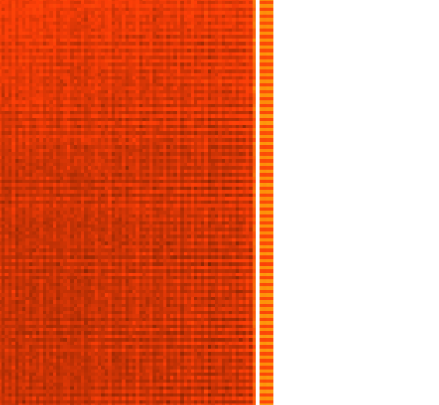
MIRI Readout
Image below is the resulting exposure from 1 integration with 100 frames
Level 1 data with reference output data rearranged at the top
Artificially shown here at the same scale – in reality reference output image is much fainter than the science image
Image of 1 frame (group)
Units of DN
Image of 1 exposure
Units of DN/s (slope)
Zoom showing reference pixels columns
Level 1
Level 2
Example image from Goddard cryo-vacuum imager test. Spherical structure in image is illumination from test optics.
MIRI has 4 amplifier outputs - each output provides 258×1024 values (1/4 array)
A 5th amplifier provides the reference output data
There is no “dead” time between frames - integration length is an integer times frame time
Timing between exposures is not controlled - dependent on latency in the IC&DH system
5

Slide 6
Subarrays
The hardware can produce subarrays of any size
9 predefined subarray readouts
Restricted choices are offered to simplify operations and calibration
Allows integration times substantially less than full frame read out time of 2.77 seconds
Can observe brighter objects
Subarray times don’t scale linearly
There are overheads - cutting your sub-array in half does not allow you to look at things twice as bright
All subarrays are read out and stored while the remaining rows of the array are continually reset
Only used if absolutely necessary for your science
Due to sub-array induced artefacts
Mandatory for coronagraphs
Imager FOV
6

Slide 7
Fast and slow mode
The electronics have the ability to sample an individual pixel multiple times before moving on to the next pixel
In FAST mode MIRI samples a pixel once during a single clock cycle
In SLOW mode many samples of a pixel are obtained in a clock cycle and a subset of them can be averaged to output a single result
Full frame, FAST mode = 2.8 sec/frame, Samples per pixel = 1
Full Frame, SLOW mode = 24 sec/frame, Samples per pixel = 8
FAST mode default for imager
SLOW mode default for MRS due to lower noise prediction and slight S/N gain for read noise limited observations
7

Slide 8
Performance and testing
MIRI flight detectors tested with the instrument (most recently) at Goddard Space Flight Centre
Additional tests with flight spare detectors and flight clone electronics at NASA JPL
Performance of the MIRI detectors has reached and, in many cases, surpassed flight requirements
Example
The well depth of the MIRI detectors is required to be greater than 100,000 e− to allow a wide dynamic range
We can integrate to well over 90% of the saturation level
The detectors have a measured well depth of approximately 250,000 e−
larger well depth allows observations of brighter objects for longer integration times
Above: Instrument loaded into the cryo vacuum chamber at NASA Goddard
Left: outside view of cryo vacuum chamber
8

Slide 9
Non-ideal behaviour
Integration
MIRI shows all effects seen in previous generations of Si:As IBC detector arrays e.g. Spitzer IRAC
With - last frame effect
Without - Droop, component proportional to total signal
However - We see the whole of the ramp!
Notable non-ideal behaviours
Reset Switch Charge Decay (RSCD)
Seen as a non-linear hook in the first frames of the ramp
Product of charge injection and clock feed through – very predictable
Last frame effect
The array is reset sequentially by row pairs. The last frame of an integration ramp on a given pixel is influenced by signal coupled through the reset of the adjacent row pair
Column and row pull down/up
Does not carry a noise penalty – modelled and removed in pipeline
Frames (groups)
Data Number
Last frame
RSCD
Time
Image from JPL detector testing without flight optics
9

Slide 10
Nonideal behaviour – memory effects
Persistence (latents) - memory of previous illumination pattern
<<0.5% of previous signal after a few minutes
Seen as an weak positive image that decays in strength exponentially with time
Time to recover is a function or previous illumination and integration time
Imprints – memory effects that do not fade in time
Seen in similar detectors (IRAC) and removed by annealing
Drifts – signal drifts with amplitudes roughly proportional to signal level
Small compared to the signal <<1%
increase in exponential manner to equilibrium at rate proportional to flux
Amplifier zero points also drift but does not effect measurement of the ramp
Persistence decay is likely one component of the cause of signal drifts
Memory effects are common to these type of detectors
These are the best examples of this type of detector ever flown - impact of memory effects thought to need correction only at the extreme end of luminosity and integration time
Image
5 min exposures
Dark after 90 seconds
Dark 2
Dark 3
10
Log scale in DN/s

Slide 11
Data from an end user perspective
Observational best practice and protocols as well as pipeline processing will correct or mitigate most of the nonideal behaviours for all but the most extreme observations
Dithering, limits the integration time in one position as well as removing cosmic rays
Persistence, decays within overheads between visits/exposures of the instrument
Background, high MIRI backgrounds dilute persistence and drifts
The pipeline currently corrects the following MIRI behaviours and on going development should improve the results even further
Bad pixels
Non-linearity
Reset switch charge decay
Cosmic ray
Persistence (correction or flagging)
Last frame (correction or rejection)
MIRI backgrounds will be high. E.g. F2550W imaging will be limited by the background to approx. 45 second integrations
F560W = 1 DN/s (≈ 5.6 e-/s)
F1280W = 19 DN/s (≈ 100 e-/s)
F1800W = 80 DN/s (≈ 450 e-/s)
F2100W = 380 DN/s (≈ 2100 e-/s)
F2550W = 790 DN/s (≈ 4400 e-/s)
MIRI fact!
11

Slide 12
Conclusions
MIRI detector performance meets and exceeds design requirements
Known non ideal behaviours are well characterised and should be mitigated or corrected during the mission
MIRI instrument team are very optimistic about performance
MIRI instrument being attached to ISIM the instrument module at Goddard
References
MIRI performance – Ressler et al. (2008, Proc. of SPIE Vol. 7021)
MIRI detectors – Rieke et al. (2015, PASP 127,665)
MIRI Focal Plane system – Ressler et al. (2015, PASP 127, 675)
MIRI predicted sensitivity – Glasse et al. (2015, PASP 127, 686)
12

